Slide 1
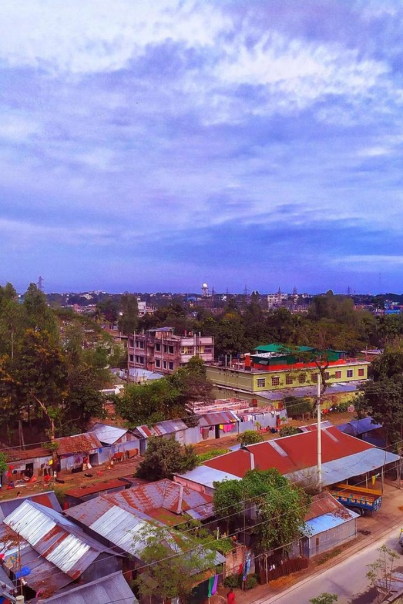

Urban Poverty in Rangpur Division, Bangladesh
A look at the causes, effects, and challenges of urban poverty in Bangladesh's Rangpur Division.
by khalek ahmed

Slide 2
Causes of Urban Poverty
Lack of Employment Opportunities
Rural-Urban Migration
Limited Access to Basic Services
Seeking better prospects, people move from rural areas, leading to overcrowding and competition for resources.
Limited job availability in formal sectors forces many into informal work with low wages and unstable conditions.
Inadequate healthcare, education, and sanitation disproportionately impact the poor, perpetuating poverty.

Slide 3
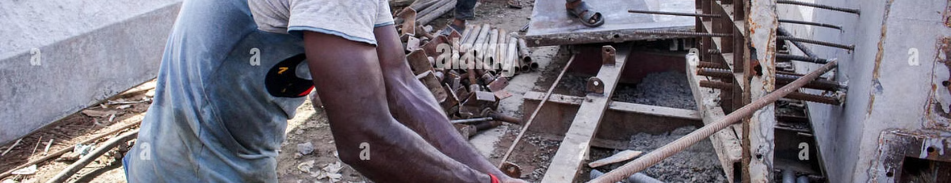
Lack of Employment Opportunities
Limited Formal Sector Jobs
Prevalence of Informal Work
Skill Gaps and Education
A lack of sufficient opportunities in established businesses and industries restricts economic mobility.
A mismatch between available jobs and skills limits earning potential and prevents upward mobility.
Many resort to informal jobs such as street vending or manual labor, which often lack benefits and security.

Slide 4
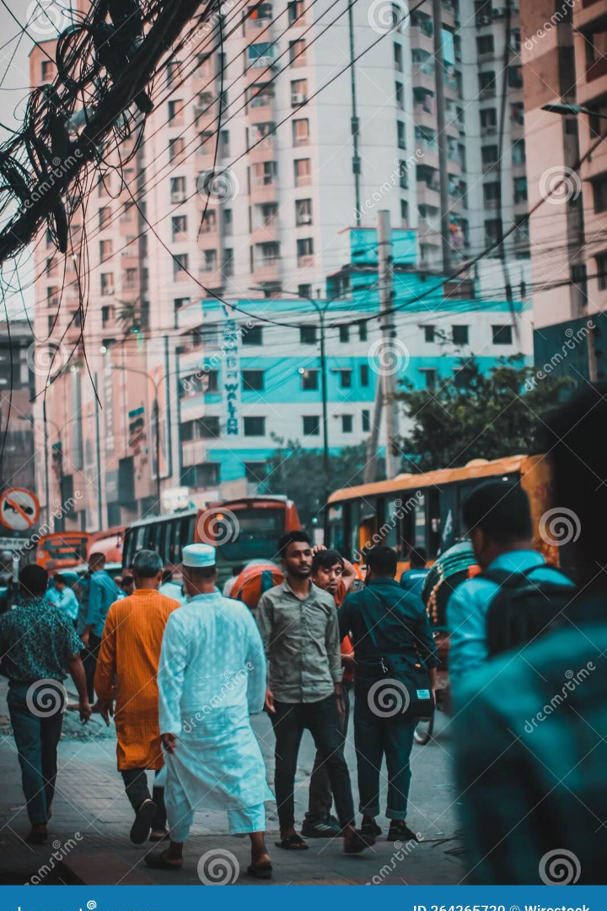
Rural-Urban Migration
1
Push Factors
Limited agricultural opportunities and low wages in rural areas drive people to urban centers.
2
Pull Factors
Perceptions of greater job prospects, education, and services in urban areas attract migrants.
3
Overcrowding and Competition
The influx of migrants leads to housing shortages, strain on infrastructure, and competition for resources.

Slide 5
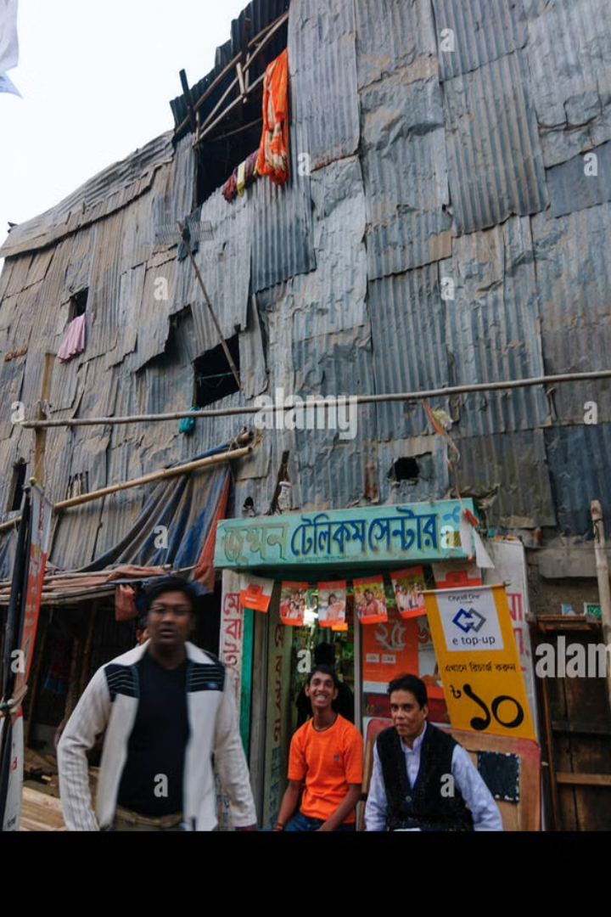



Limited Access to Basic Services
Inadequate Healthcare
Limited access to quality healthcare, especially for the poor, contributes to illness and lower life expectancy.
Limited Education Access
Lack of affordable quality education hampers skill development and opportunities for socioeconomic advancement.
Poor Sanitation and Housing
Unsanitary conditions and substandard housing increase the risk of disease and hinder overall well-being.

Slide 6




Effects of Urban Poverty
1
Poverty Trap
2
Malnutrition and Poor Health
3
Inadequate Housing and Sanitation
4
Social Exclusion and Crime

Slide 7
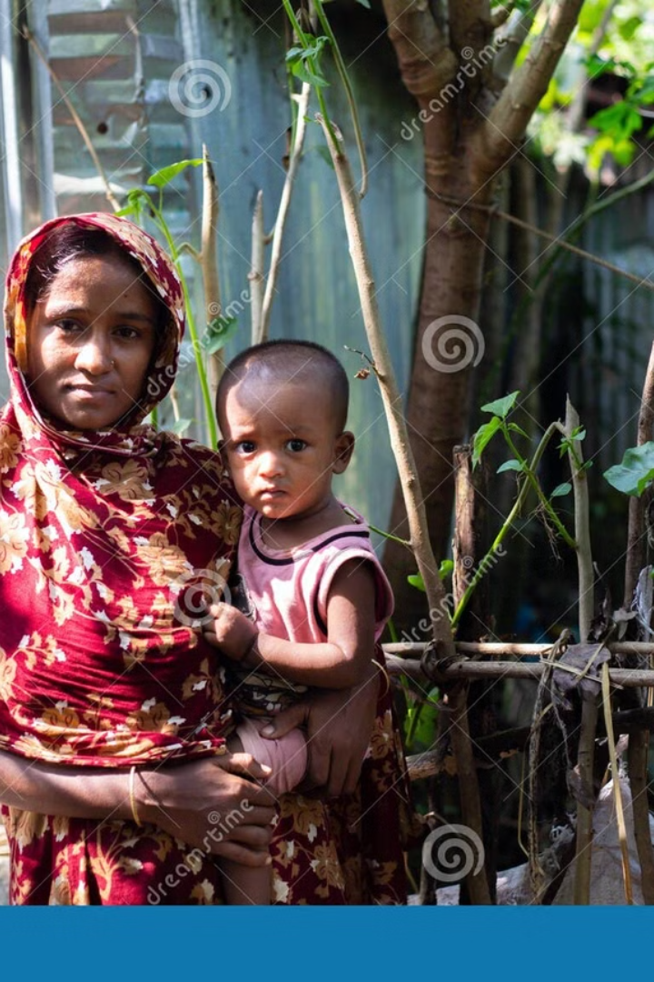



Malnutrition and Poor Health
Inadequate Diet
High Prevalence of Disease
Low income restricts access to nutritious food, leading to malnutrition, especially among children.
Poor sanitation and limited access to healthcare increase the risk of infectious diseases.
Limited Access to Healthcare
Financial constraints and lack of nearby facilities hinder timely and effective medical treatment.

Slide 8
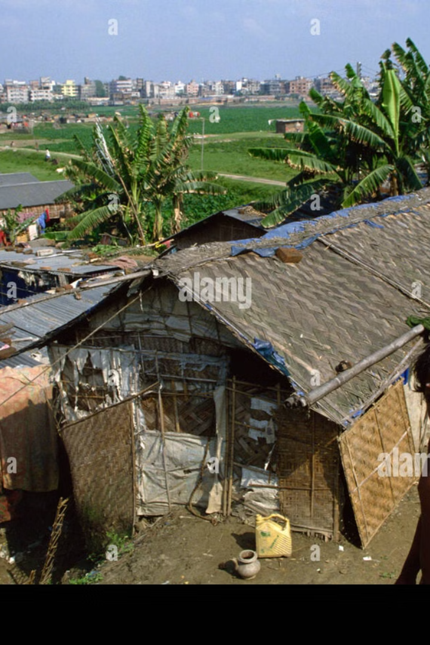
Inadequate Housing and Sanitation
Overcrowding
Lack of Basic Amenities
Limited affordable housing forces families to live in cramped, unsanitary conditions, posing health risks.
Many lack access to clean water, electricity, and proper sanitation facilities, affecting quality of life.
Informal Settlements
Informal settlements lack proper infrastructure and legal recognition, making residents vulnerable to displacement.

Slide 9
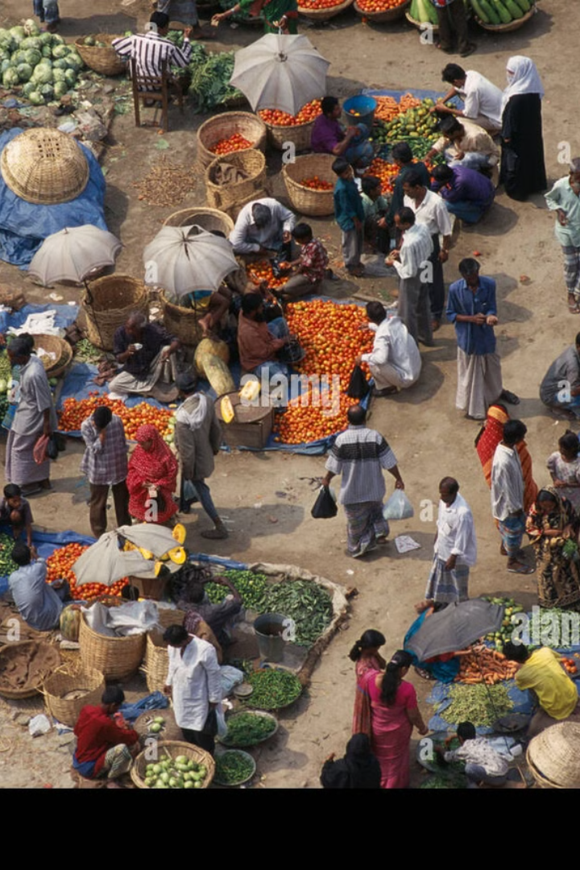
Social Exclusion and Crime
2
3
Social Exclusion
Increased Crime Rates
Poverty often leads to social isolation and discrimination, limiting access to opportunities.
Desperate circumstances drive some individuals towards criminal activities to survive, creating social unrest.
1
Limited Access to Resources
Poverty restricts access to education, healthcare, and social services, perpetuating disadvantage.

Slide 10
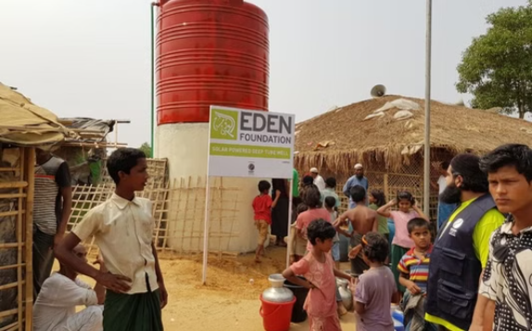
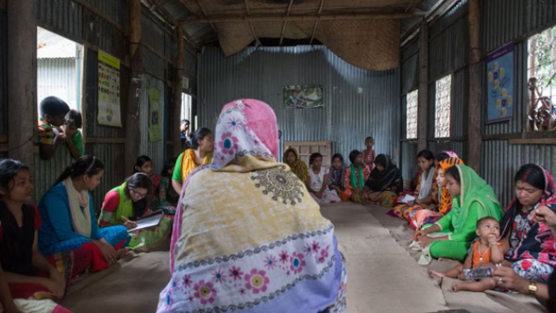
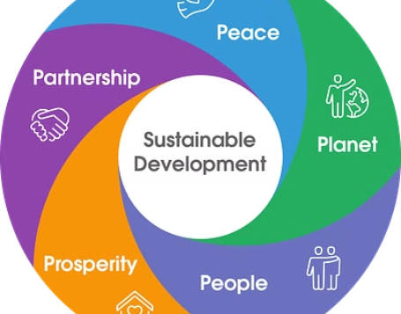
Challenges in Addressing Urban Poverty

